Slide 1

November 03, 2024

Slide 2

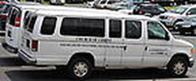
WELCOME
EAST BALTIMORE CHURCH OF CHRIST
The Church of Christ in East Baltimore welcomes you. We rejoice in your presence today. We pray that the services rendered will be edifying and profitable to you. It is our pleasure to proclaim the glad tidings of our Lord and Savior, Jesus Christ. We ask that you take the time to complete a visitor’s card, so that we may know who you are and be able to personally greet you following worship service. As a way of recognizing you, we ask that you stop by the Visitors’ Table located in the over-flow area (to the right, adjacent to the blinds) and receive a special gift that has been prepared, especially for you!
The Nursery is open. Please note the posted use protocols when utilizing the room. Children (infants – 3 years old) are to be accompanied by an adult. We thank you for visiting and look forward to seeing you again at the Church of Christ in East Baltimore. Please see Sis . Adrienne Calhoun for more information.
Senior Minister
Kevin Bethea
410-371-4391
Assistant Ministers
Geoffrey Veale
410-812-5882 or
443-794-0956
Gregory Claiborne
410-340-4994
Worship Ministry Leader
Charles Minnis
443-255-5662
Finance Minister Leader
Leslie Rogers
410-804-9528
Youth Education Ministry Leader
Sterling Harlston
410-356-5382
CHURCH SECRETARIES
Ornetta Craig
443-858-2127
Minnie Cooper
443-418-8115
Kiva Harris
443-604-0598
Enroll in our free, 8-week Bible Correspondence Course consisting of a series of lessons based on a certain theme, or for a specific purpose. Please see Bro. or Sis. Cooper for more information.
Communion supplies will only be available for pick up at the building on the third Saturday of the month, from 10 am to 12 pm. Your offering may also be dropped off at any time; there is a new drop box that can be accessed from outside the doorway of the administrative offices.
Please remember to turn off all cell phones during Worship Service and Bible Study Classes.
VAN SERVICE IS SUSPENDED UNTIL FURTHER NOTICE
Page | 2

Slide 3
WEEKLY EVENTS
SUNDAY
Morning Worship, 8AM & 11AM
Bible School (for all ages) 9:45AM
(In Person and Remotely)
Last Sunday of the month Combined Worship Service
Morning Worship, 11AM only.
Faith Builders (ages 4 -11) 11:30 AM
WEEKLY CLASSES
TUESDAY
Men’s & Ladies Class, 7:30PM (Zoom Meeting & conference call))
WEDNESDAY
Bible Study 7:30PM [Facebook, YouTube, Twitter]
Foundations of Faith 7:30PM [Google Meets] Must sign up
THURSDAY
Morning Study, 11:45AM
[Conference Call]
Bible Table Talk 7:00 PM [Facebook, YouTube]
MONTHLY EVENTS
Ministry Leaders Meeting
1st Monday of every quarter.
Senior’s Ministry
Bi-Weekly Conference Call
Every 2nd & 4th Friday at 7:00pm
Please dial: 605-313-4836; access code 780919# -- NO PASSCODE NEEDED
Marriage Enrichment
2nd and 3rd Sunday of each month at 9:45AM in NBBIC classroom.
Soul Care Grief Counseling
In person on Saturdays at 1PM (Time subject to change)
IT will be announced when ALL THE MINISTRIES NOTED BELOW will resume.
Parenting with a Purpose
Education Department
F.A.M. ( previously S.U.R.E. Blessings)
EMERGENCY CLOSING INFORMATION
In times of bad weather and other emergencies, tune to:
WRBS 1230 AM 95.1FM WJZ Channel 13 WJZ.com
DAILY SCRIPTURAL DEVOTION:
Week of 11/03/2024 (Read in both common language and KJV)
Monday | Revelation | Chpt. 9
Tuesday | Revelation | Chpt. 10
Wednesday | Revelation | Chpt. 11
Thursday | Revelation | Chpt. 12
Friday | Revelation | Chpt. 13
Saturday | Revelation | Chpt. 14

Slide 4
R-Repentance; SG-Spiritual Growth; FM-Family Members; HS-Health and Strength; GG-God’s Guidance;
MP -Medical Procedure; TG-Traveling Grace; TK-Thanksgiving; M-Mourning; CW-Co-Worker(s);
Spiritual Strength- SS, CM-Church Members, FF-Family Friend(s); DM-Decision Making; W-Work Providential Care (PC)
pl
Bro. & Sis. Veale (SG, HS, FM)
Bro. & Sis Leslie (SG, FM, HS)
Bro. Terrent Small (SG, HS)
Bro. & Sis. Boone (FM)
Bro. Clifford Anderson (SG, HS)
Bro. & Sis. Fowler (SG, HS)
Bro. & Sis. Motely (SG, FM, HS)
Bro. & Sis. Terrell (TG)
Sis. Doris Washington (FM)
Bro. Austin Veale (SG, FM, HS)
Sis. Helen Spann (SG, FM, HS)
Sis. Tracy Walker (SG, FM)
Sis. Rita Fobbs (SG, FM, HS)
Sis. Janell Bryant (HS)
Sis. Lona Small (SG, FM)
Sis. Eleanor Holt (FM, HS)
Bro. Tucker (FM, HS)
Bro. Kenico Hines (SG, FM)
Bro. & Sis. Haynes (SG, FM)
The Mercer Family (TG)
The Simms Family (SG, FM)
The Eckels (SG, FM)
The Jones Family (SG, FM)
The Stanley Family (SG, FM)
The Fields Family (SG, FM)
Bro. & Sis Haynes (SG, FM)
Sis. Estelle Williams (FM, HS)
Sis. Linda Claiborne (FM, HS)
The Ward Family (SG, FM)
Bro. Dontanian Tyson (SG, FM)
Sis. Betty Chappell (SG, FM, HS
PRAYER REQUESTS:
All Members of East Baltimore COC
Bro & Sis Bethea (Tg, FM)
Bro Veale ( SG, HS, FM)
Bro & Sis Sharpe (SG, FM, H&S, CM)
Bro & Sis McCall (H&S, TKS)
The Kings (SG, FM, CM, H&S)
Bro Kenico Hines (SG, FM)
Sis Tracy Walker ( SS, GG, TKS, H&S, TG)
Sis Helen Spann (H&S, SG, FM, CM)
Bro Achaniel Lucas (HS, FM, FF,CM)
The Claibornes ( H&S, FM, CW, TG)
Sis Darlene Grant(FM, H&S, MP, TKS)
Sis Jeanette Ortegon (H&S, SG, FM)
Sis Shalawnda Suggs (FM, TKS, SG)
Sis Gwen Jackson (SG, FM PC, GG)
Bro & Sis Washington (FM, TKS, M, SS)
Sis Kim Hamilton (FM, H&S)
Sis. Eleanor Holt (H&S, FM, CM, TKS)
Sis. Ebony Bannister (FM, SG, HS, TKS, GG)
Sis Edna Cousin (H&S)
Sis Tamlyn Franklin (FM, GG, DM, TG)
Sis Emmani West(H&S, FF TG, SG, FF, DM, H&S))
Sis Helen Spann (FM, SG)
The Mercer family (FM H&S, TG, CW M)
Sis Geraldine Dixon (FM H&S)
Sis Antoinette Gross (FM)
Sis Geraldine Dixon (FM, SG, H&S)
Bro Sharlon Binesar (GG, SS)
Sis Edna Cousin (H&S, TKS, SS)
Sis Shika Jenkins(FM,W)
Sis Lorertta Caston (H&S)
Sis Cherry Moody (SG, TKS, CM)
Sis Aniyah Warfield (FM H&S)
Sis Sonya McNeill (FM SS,)
Sis Marilyn Artis (SG)
Sis Sharon Troy (MP)
Sis Annika Adams (R, FM, SS, GG, H&S, FM)
Sis Paulette Simms (FM, CM )
Sis Nikia Sinkler (H&S, R)
Bro Antwan Washington (TG)
The Blyes ( SG)
Sis Particia Truesdale (FM H&S, SG)
Sis Afrose Gamber (FM H&S, GG)
Sis Tracy Walker (SS)
Sis Jill Hutchinson (TKS, SG)
Sis Destiny Franklin (W, ST, SG, PC)
Sis Dionne Ward(FM H&S)
Sis Alicia Thomas (FM)
Sis Charmaine Thomas (SG, FM, TG)
The Boone family (DM, FM, SCH)
Sis Alesha Francis (TG, FM)
Sis Kimberly Griffin (FM, SS, SG)
Sis Arlene Motley (SG)
Bro Sharlon Binesar and family (PC)
Sis Alice Brooks (FM)
Sis Cherry Moody (FM, SG, H&S
EDGEWOOD COC
Bro Ken Robinson (SS, TKS, H&S)
Sis Alesha Francis (FM)
Bro Christopher Tillery (GG, TG, PC)
Niles Wilkie (H&S)
Sis Tara Vinson (FM)
Bro Marcus Miles (FM, SS)
The Mendoza Camacho family (H&S,FM)
Sis Janice Brent (FM)
Bro Michael Tillery (H&S)
Sis Michelle Crump (H&S, MP, FM, SG)
Bro William Long (H&S)
Sis Lisa Long, (FM H&S)
Sis Alesha Francis (FM H&S)
Sis Sharon Moore (H&S)
Sis Erica Payne (TG)
SICK AND SHUT-IN:
Sis. Paula Thomas (HS)
Sis Shirley Tyler (HS, SS)
Sis Danielle Williams (SS)
Bro Clarence Williams
Bro James and Sis Hazel Leslie (H&S, SS, FM,PC)
The Ballards (H&S, MP)
Sis Antionette Gross ( H&S)
The Bennett Family (M)
REQUEST FOR OTHERS:
James & Heidi Holmes (H&S)
Marva Webster
Florence Hawkins (H&S)
Maxine Johnson (H&S)
Marci McCall (H&S)
The Ellerbes (H&S, SS)
The McClain family(H&S)
Sis Mozella Parks (H&S, SS)
Bro Artist Jamez (FM)
Sis Diana Williams ( H&S, FM)
Bro William Whitaker (H&S)
Mya Jackson (FM H&S)
Sis Pamela James (FM, FM TG, TKS)
Bro Erik Gerald (R< SG, FM)
Sis Barbara Goodman (H&S)
Pamela Cannady
Bob Deweese 9H&S)
Don Mouzon (M)
Gregory Brown (H&S)
Denise Dunlap
Deborah Rite
Elizabeth Logan
Lonnie Moore (SS)
Nick Service (H&S)
Steve Grossman (H&S)
Sis Angela Womack (FM, FF, W)
Sis Diamond Snowden (FM, GG, PC)
Mike Brindell (H&S)
Kay Carter (GG)
Chelsey (M)
Sis Jennie Johnson (FM H&S, TG)
Denise Dunlap (TH, SG)
Willard Derry (H&S)
Sis Daija McCall (SG, SS)
Debby Wolfe (MP)
Don Mouzon (M)
James & Linda Robinson
OTHER INTERCESORY PRAYERS :
Please continue to pray for all who are dealing with the effects of COVID, RSV, and other viruses and flus that are affecting the health care system.
Let’s continue to pray for our Elected Officials, our government, and the entire world.
Let us pray for all who have been affected by gun violence and mass shootings, and for the families and those who have been injured or killed.
Let us pray for those who continue to be caught in wars
Let us continue to pray for the Churches of Christ worldwide, especially for our East Baltimore and Edgewood Families. Let’s continue to pray for all who continue to worship virtually from home. Let us pray especially for all who have fallen away.
Let us continue to pray for the homeless and those without hope. Let us pray for all who are struggling spiritually, physically, mentally, and emotionally.
Let us pray for the all the ministries and classes taking place at East Baltimore, and for the Teachers who are working to equip us as Leaders and workers involved in Kingdom Business.
Let us pray for all who are lost without GOD.
All families that are suffering losses de to the bridge collapse.
Mourning:
Visit and Encourage
Let us continue to pray for those who are mourning losses at this time.
Page | 5
Notes:
,,

Slide 5
CHANGE IN LIVE-STREAM/CONFERENCE CALLS INFORMATION FOR SUNDAY SERVICES AND BIBLE CLASS AND WEEKLY CLASSES
EBCoC has reopened the building to 100% capacity for 8:00 a.m. and 11:00 a.m. Services can be viewed virtually as well. Masks are no longer required. Our Sunday morning 9:45 a.m. bible class is both in-person and virtual. Tuesday night Men’s and Ladies’ Bible Classes at 7:30 p.m., Wednesday night bible class, and 7:00 p.m. Thursday night Bible Table Talk all remain live streamed through social media, via the following:
Facebook <https://www.facebook.com/ebcocbelair/>
Youtube <https://www.youtube.com/channel/UCPYGjhGQlfmc1Pxir5zcBvg>
Twitter <https://twitter.com/EastBaltCoC>
Through the church’s website (www.eastbaltimorecoc.com) you can submit prayer requests and give offering by clicking on ’Online Giving’.
UPDATE INFORMATION: The conference call lines now require 'PASSCODES’. All conference access codes remain unchanged for all services and classes. The use of passcodes is effective Sunday, January 10th, and are noted in RED below.
Sunday early morning worship (8AM) is available, via conference call, at 8:00am
(Please dial in: 646-558-8656; access code 104958185#, passcode: 0800#)
Sunday morning bible class is available, via conference call, at 9:45am
(Please dial in: 646-558-8656; access code 612196159#, passcode: 0945#)
Sunday mid-morning worship (11AM) is available, via conference call, at 11:00am
(Please dial in: 646-558-8656; access code 955223296#, passcode: 1100#)
Men’s Tuesday night bible class is available, via conference call, at 7:30pm
(Please dial in: 646-558-8656; access code 89010305885#, passcode: 9420#)
Sisters’ Tuesday night bible class is available, via conference call, at 7:30pm
(Dial in: 646-558-8656; access code 503887784#, Passcode: 277032#)
Wednesday night bible class is available, via conference call, at 7:30pm
(Please dial in: 646-558-8656; access code 914483290#, passcode 0730#)
Thursday MORNING bible class is available, via conference call, at 11:40am
(Please dial in: 518-318-5372; (NO PASSCODE NEEDED)
Thursday night (“Bible Table Talk”) is available via conference call, at 7:00pm
(Please dial in: 646-558-8656; access code 750890472#, passcode 0700#)
Seniors’ Bi-Weekly Conference (every 2nd & 4th Friday) via conference call, at 7:00pm
(Please dial in: 605-313-4836; access code 780919#) (NO PASSCODE NEEDED)

Slide 6

Soul
Serving the Community
The Pantry food distribution will resume next Saturday January 20th , 2024
Our Soul Food Pantry is fully operational, and we are distributing food the 3rd Saturday of each month from 10:00-12:00 p.m. The schedule of operation is as follows:
1st Saturday – Filling pantry with non-perishable items (*see list of items to be donated and collected below)
2nd Saturday – Packing of Bags to be distributed
3rd Saturday – Distribution of Food on a first come, first served basis
*Items Needed to keep Pantry stocked:
Canned Vegetables – green beans, peas, corn, beets, tomatoes, kidney beans, baked beans
Beans – Garbanzo, navy, dry beans, split peas
Cereals – Dried Oatmeal or other cereals
Pasta – Spaghetti, macaroni, ramen noodles, macaroni & cheese
Canned Chicken, Spam, Tuna Fish, Salmon, Sardines
Canned Soups & Broths *Beef Stew *Mayonnaise *Rice *Corn Meal
Flour *Biscuit Mix *Sugar *Peanut Butter *Jelly or Jam *Canned Fruit
Remember: NO BULK ITEMS PLEASE: Please bring separate items and not bulk, institutional-size food items/cans. Also, if possible, please bring in 10-12 of each item you are donating; i.e., 10 boxes of cereal, 12 cans of soup, etc. Please do not bring in unsuitable items, i.e., dented or rusted canned goods, old or expired foods, and discarded items from your pantry.
For more information, please follow-up with Bro. Kenico Hines.

Slide 7
BIRTHDAYS/ ANNIVERSARIES/ BAPTISIMS/
PLACED MEMBERSHIP
NOVEMBER CHRISTIAN BIRTHDAYS |  | NOVEMBER BIRTHDAYS
Sapphire Boone Ralph Brown Sterling Harlston Godfrey Inheanacho | Danielle Jackson Elliot Shisiali Christian Smith | Noah Griffin Kinsley Griffin James Leslie Antoinette Gross Vance Cargill CJ Minnis Patrick Hines Bergeda Minnis | Terrent Small Geoffrey Veale Aaron James Immanuel Inheanacho Charles Minnis Camden Williams Sean Suggs
BAPTIZED Congratulate our newest young Brother Johnathan Bennett of the Harford county Church of Christ.
NOVEMBER ANNIVERSARIES |  | PLACED MEMBERSHIP
John & Afrose Gamber Andre & Tracey Millon

Slide 8
HAPPY BIRTHDAY TO OUR MEMBERS!
For those members who have a birthday during the week (from Sunday through Saturday), HAPPY BIRTHDAY! We ask that you too, stop by the Table in the over-flow area, to receive a birthday bag prepared with you in mind! All members should make sure that you give your birthday information to Sis Ornetta Craig to make sure that we recognize you for your special day during that week.
**********************************************************************************************
A calendar of planned Church events can be accessed on the Churches webpage under the resources tab or through this link
RESOURCES | EAST BALTIMORE CHURCH OF CHRIST (eastbaltimorecoc.com) .
***********************************************************************************************
Wonderful Wednesdays in the Word Bible Study live streamed 7:30-8:30 PM.
In person class is suspended until further notice
Wednesday night bible class is available, via conference call, at 7:30pm
(Please dial in: 646-558-8656; access code 914483290#, passcode 0730#)
Facebook, East Baltimore Church of Christ – YouTube
Zoom login information sent out by email.
**********************************************************************************************
East Baltimore COC 4th Sunday Combined Worship service is November 24^{th.}
No 8AM service. Regular 9:45 Bible Study and 11 AM Worship Service.
+++++++++++++++++++++++++++++++++++++++++++++++++++++++++++++++++
Men’s prayer breakfast Saturday November 9, 2024. See flyer below.
+++++++++++++++++++++++++++++++++++++++++++++++++++++++++++++++++++++
Please remember to sign in when entering the building for Worship Service.
+++++++++++++++++++++++++++++++++++++++++++++++++++++++++++++++++++++
Senior Ministry Summit, Friday December 13, 2024. 7 pm
(dial in: 605-313-4836; access code 780919#) (NO PASSCODE NEEDED)
++++++++++++++++++++++++++++++++++++++++++++++++++++++++++
Who: Sis. Nia McNair - was selected for the Baltimore County Public Schools All-County Orchestra as a 3rd-chair cellist! (AMEN!)
When: Saturday - November 9, 2024
Time: 2:30PM
Location: Carver Center for Technology and Arts High School - 938 York Road - Towson, MD 21286
Free event
ANNOUNCEMENTS

Slide 9

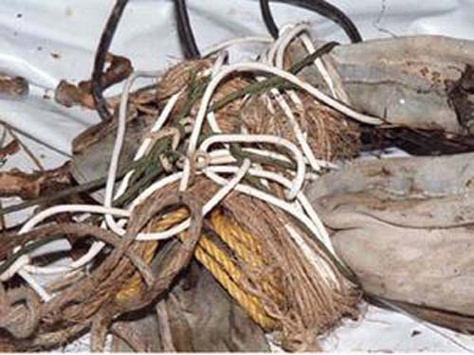
Tuesday Night Men & Ladies Classes
EBCoC Tuesday Night
Men’s Class
“BAND OF BROTHERS”
Church of Christ in East Baltimore
SISS (Sisters In Sacred Studies)
2 Timothy 2:15 “Study to shew thyself approved unto God, a workman that needeth not to be ashamed, rightly dividing the word of truth”.
Ecclesiastes 4:12 “Though one may be overpowered, two can defend themselves. A cord of three strands is not quickly broken.
Every Tuesday Nights at 7:30 PM
Host: Bro Kevin Bethea
Zoom App Manual entry:
Meeting ID: 890 1030 5885
Password: 9420
Call-in Number: +19292056099
Meeting ID: 890 1030 5885
Password: 9420#
The SISS group meets every Tuesday. During the month of October, Sister Jill Hutchinson will lead the class.
Sisters’ Tuesday night bible class is available, via conference call, at 7:30pm (Please dial in: 646-558-8656; access code 503887784#, passcode: 277032#)
It is also available via Zoom https://zoom.us/j/503887784?pwd=Qm5CYzh6Z3hKSUpBKzVUQnZyV1pBUT09
Meeting ID: 503 887 784
Password: 277032
If you are interested in teaching in the Tuesday Night Ladies Bible Class rotation, please contact Sister Gina Dashiell@ (410-419-3013).
Zoom APP:
https://us02web.zoom.us/j/89010305885?pwdVzZQM2VKSWFDN2NPUUUIBwcDUxbzdQUT09

Slide 10
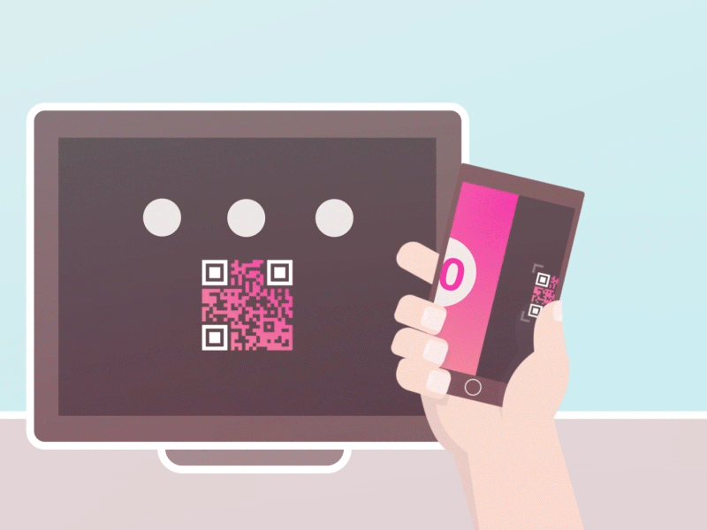
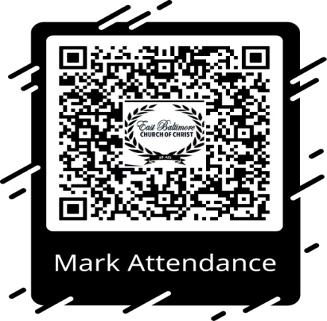


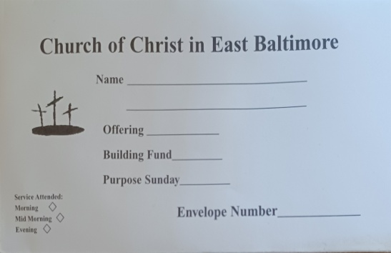
We have a new attendance check-in method for all viewing worship service via Facebook or YouTube.
ATTENDANCE TRACKING
You will now be able to check-in using the QR Code scanner on your mobile device. If you don’t have a QR code scanner on your device, you can download it from Google play store or the Apple app store. This code will be displayed at the beginning of the worship service.
GIVING
Go to the East Baltimore Church of Christ web site, eastbaltimorecoc.com
and click on online giving.
CashAPP is no longer available as an avenue for giving, please us Simple Give until an alternative is available.
GIVING | EAST BALTIMORE CHURCH OF CHRIST (eastbaltimorecoc.com)
COLLECTION ENVELOPE:
As a reminder, please complete contribution envelopes with the following printed clearly: First and Last Name and the $ amount of your offering.

Slide 11
CARE GROUP MEETING DATES AND ZIP CODE AREA INFORMATION
Care Group Meeting Schedule for November
The SAR DC Group, will meet this afternoon. Our Care Groups meet on a rotating basis, on Sundays at 4:30 p.m., via Zoom (Zoom ID: 824-3855-2255 – Passcode: 1500), and via Conference Call (646-558-8656 – ID: 824-3855-2255 – Passcode: 1500). The Care Groups are not just for the Care Group members, but anyone who is in need of mutual fellowship opportunities.
Please make sure you know in which Care Group you belong. If you are unsure, check below for your zip code information and connect with your Care Group Leader. Please provide your Care Group Leader with your current home and email addresses and phone number so that the Church is able to reach you with any updated church information and keep you informed of current activities.
Bro. Dashiell’s Ephesians-East DC Group |  |  |  |  |  |  |  | Bro. King’s Servants of Righteousness DC Group
(Meets 1st Sunday of the month) |  |  |  |  |  |  |  | (Meets 2nd Sunday of the month)
 |  | 21030 |  | 21218 |  |  |  | 21041 |  | 21207
 |  | 21202 |  | 21224 |  |  |  | 21042 |  | 21215
 |  | 21205 |  | 21226 |  |  |  | 21044 |  | 21228
 |  | 21212 |  | 21231 |  |  |  | 21045 |  | 21229
 |  | 21213 |  | 21239 |  |  |  | 21046 |  | 21233
 |  | 21214 |  | 21286 |  |  |  | 21117 |  | 21244
 |  |  |  |  |  |  |  | 21133 |  | 21136
Bro. Antwan Washington’s Berean DC Group |  |  |  |  |  |  |  | Bro. Geoffrey Veale’s The CREW DC Group
(Meets 3rd Sunday of the month) |  |  |  |  |  |  |  | (Meets 4th Sunday of the month)
 | 21128 |  |  | 21222 |  |  |  | 21060 |  | 21230
 | 21087 |  |  | 21221 |  |  |  | 21090 |  | 21211
 | 21162 |  |  | 21234 |  |  |  | 21093 |  | 21217
 | 21206 |  |  | 21236 |  |  |  | 21094 |  | 21223
 | 21219 |  |  | 21220 |  |  |  | 21205 |  | 21225
 | 21040 |  |  | 21784 |  |  |  | 21208 |  | 21227
 | 21009 |  |  | 21015 |  |  |  | 21209
 | 21078 |  |  | 21002
 | 21005 |  |  | 21901
 | 21921 |  |  | 21001

Slide 12


Slide 13
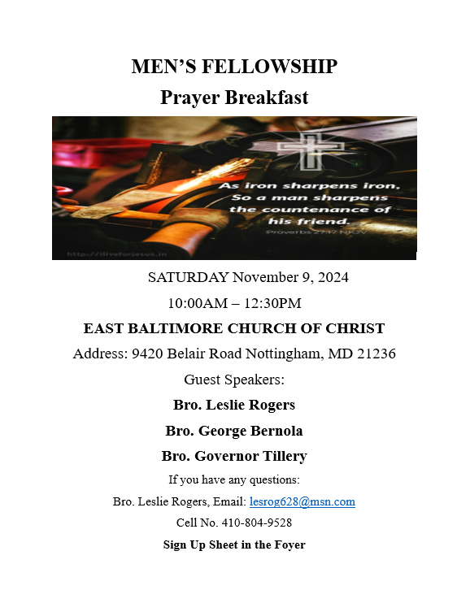

Slide 14

Online registration is now open! Take advantage of early bird pricing—just $65 for the first 100 registrants. After that, the price will increase to $75 for the next 100, and then to $90 once those spots are filled. Visit our website for details on banquet tickets, Minister’s and Leadership Appreciation Breakfast, and Ladies program. Special discounted rates are available for youth ages 5-11 and 12-17. Secure your tickets early to enjoy the best savings! Payment plan options are available.

